Slide 1
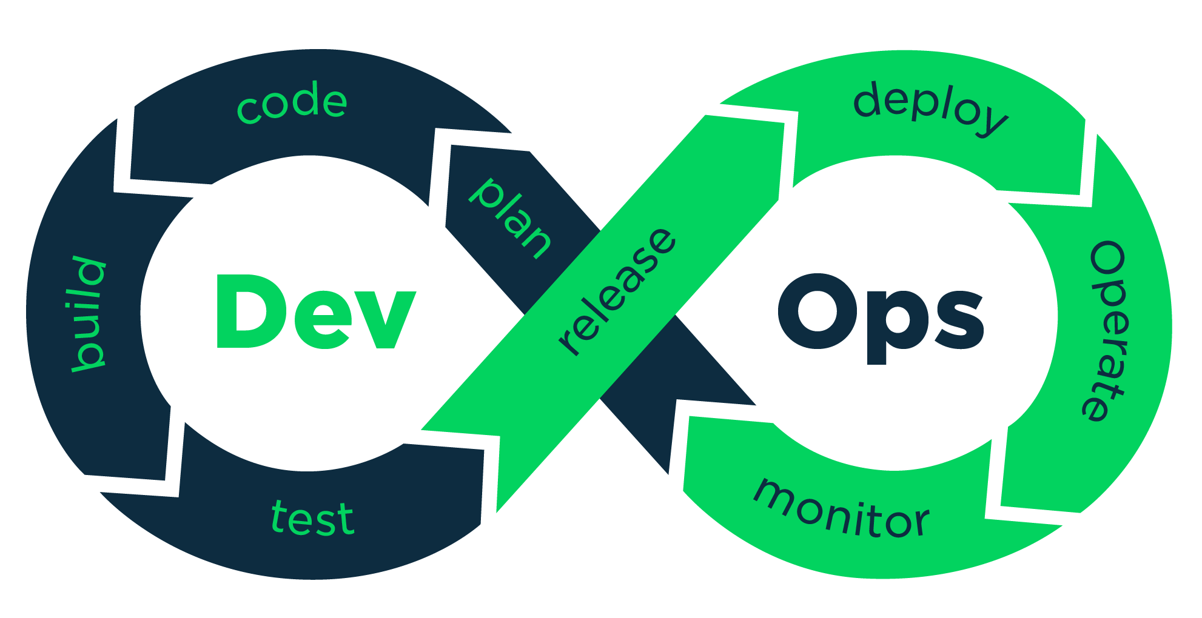

Jenkins Architecture
Jenkins Master & Slave Architecture

Slide 2
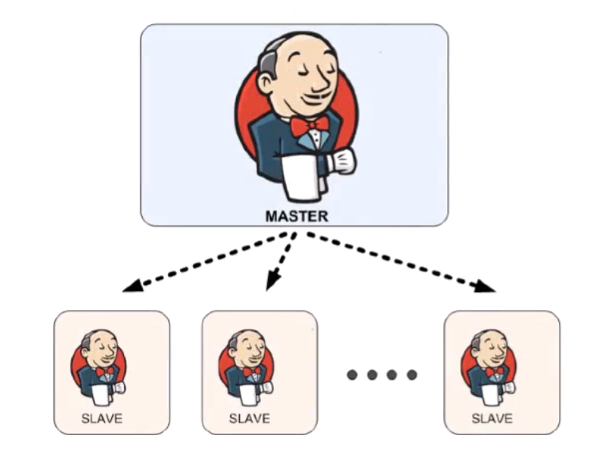
Master : 1. Schedule Build Job 2. Dispatches Builds to the Slave for Actual Job Execution 3. Monitoring the Slave and recording the build Results. Salve : 1. Execute Builds Jobs dispatched by master

Slide 3
Jenkins : Job - Slave
Jenkins Job Job is refer to runnable tasks that are controlled and monitored by Jenkins.
Slave/ Node
Slaves are computers that are setup to build Projects for a Master.

Slide 4
Jenkins : Slave
Jenkins Run Separate Program called ‘Slave Agents’ on Slaves.
When Slaves are registered to a master, a master starts distributing the load to Slaves.
Node is used to refer all machines that are part of Jenkins grid, slaves and master.

Slide 5
Jenkins : Executor
Executor is separate Stream of Builds to be run on a Node in Parallel.
A Node can have one or more Executors.

Slide 6
Jenkins : Plugins
A Plugin, like plugins on any other system, is a piece of software that extends the core functionality of the core Jenkins Server.

Slide 7


